Slide 1
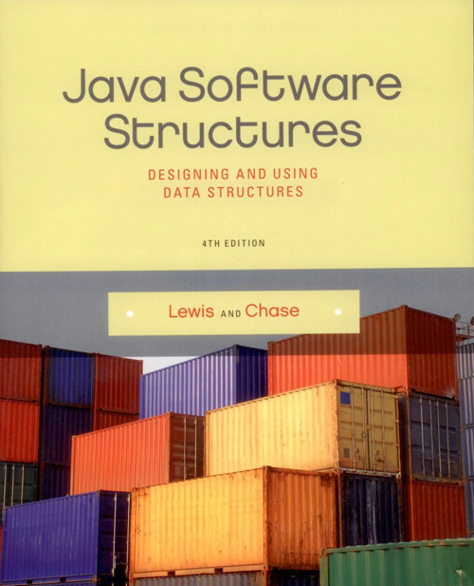
Chapter 15
Graphs

Slide 2
Chapter Scope
Directed and undirected graphs
Weighted graphs (networks)
Common graph algorithms

Slide 3
Graphs
Like trees, graphs are made up of nodes and the connections between those nodes
In graph terminology, we refer to the nodes as vertices and refer to the connections among them as edges
Vertices are typically referenced by a name or label
Edges are referenced by a pairing of the vertices (A, B) that they connect
An undirected graph is a graph where the pairings representing the edges are unordered

Slide 4
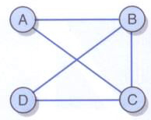
Undirected Graphs
An undirected graph:

Slide 5
Undirected Graphs
An edge in an undirected graph can be traversed in either direction
Two vertices are said to be adjacent if there is an edge connecting them
Adjacent vertices are sometimes referred to as neighbors
An edge of a graph that connects a vertex to itself is called a self-loop or sling
An undirected graph is considered complete if it has the maximum number of edges connecting vertices

Slide 6
Undirected Graphs
A path is a sequence of edges that connects two vertices in a graph
The length of a path in is the number of edges in the path (or the number of vertices minus 1)
An undirected graph is considered connected if for any two vertices in the graph there is a path between them

Slide 7
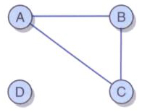
Undirected Graphs
An example of an undirected graph that is not connected:

Slide 8
Cycles
A cycle is a path in which the first and last vertices are the same and none of the edges are repeated
A graph that has no cycles is called acyclic

Slide 9
Directed Graphs
A directed graph, sometimes referred to as a digraph, is a graph where the edges are ordered pairs of vertices
This means that the edges (A, B) and (B, A) are separate, directional edges in a directed graph

Slide 10
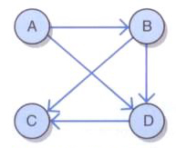
Directed Graphs
A directed graph with
vertices A, B, C, D
edges (A, B), (A, D), (B, C), (B, D) and (D, C)

Slide 11
Directed Graphs
Previous definitions change slightly for directed graphs
a path in a direct graph is a sequence of directed edges that connects two vertices in a graph
a directed graph is connected if for any two vertices in the graph there is a path between them
if a directed graph has no cycles, it is possible to arrange the vertices such that vertex A precedes vertex B if an edge exists from A to B

Slide 12
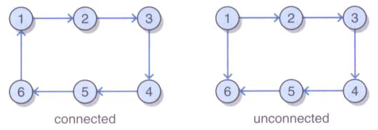
Directed Graphs
A connected directed graph and an unconnected directed graph:

Slide 13
Weighted Graphs
A weighted graph, sometimes called a network, is a graph with weights (or costs) associated with each edge
The weight of a path in a weighted graph is the sum of the weights of the edges in the path
Weighted graphs may be either undirected or directed
For weighted graphs, we represent each edge with a triple including the starting vertex, ending vertex, and the weight (Boston, New York, 120)

Slide 14
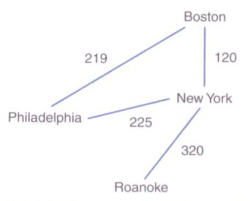
Weighted Graphs
We could use an undirected network to represent flights between cities
The weights are the cost

Slide 15
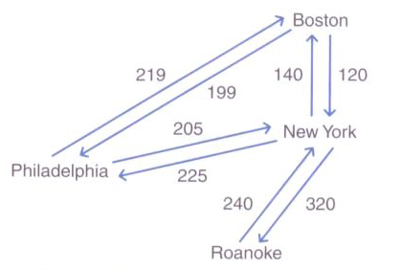
Weighted Graphs
A directed version of the graph could show different costs depending on the direction

Slide 16
Common Graph Algorithms
There are a number of a common algorithms that may apply to undirected, directed, and/or weighted graphs
These include
various traversal algorithms
algorithms for finding the shortest path
algorithms for finding the least costly path in a network
algorithms for answering simple questions (such as connectivity)

Slide 17
Graph Traversals
There are two main types of graph traversal algorithms
breadth-first: behaves much like a level-order traversal of a tree
depth-first: behaves much like the preorder traversal of a tree
One difference: there is no root node present in a graph
Graph traversals may start at any vertex in the graph

Slide 18
Breadth-First Traversal
We can construct a breadth-first traversal for a graph using a queue and an iterator
We will use the queue to manage the traversal and the iterator to build the result
Breadth-first traversal algorithm overview
enqueue the starting vertex, and mark it as “visited”
loop until queue is empty
dequeue first vertex and add it to iterator
enqueue each unmarked vertex adjacent to the dequeued vertex
mark each vertex enqueued as “visited”

Slide 19
/**
* Returns an iterator that performs a breadth first
* traversal starting at the given index.
*
* @param startIndex the index from which to begin the traversal
* @return an iterator that performs a breadth first traversal
*/
public Iterator<T> iteratorBFS(int startIndex)
{
Integer x;
QueueADT<Integer> traversalQueue = new LinkedQueue<Integer>();
UnorderedListADT<T> resultList = new ArrayUnorderedList<T>();
if (!indexIsValid(startIndex))
return resultList.iterator();
boolean[] visited = new boolean[numVertices];
for (int i = 0; i < numVertices; i++)
visited[i] = false;
traversalQueue.enqueue(new Integer(startIndex));
visited[startIndex] = true;

Slide 20
while (!traversalQueue.isEmpty())
{
x = traversalQueue.dequeue();
resultList.addToRear(vertices[x.intValue()]);
// Find all vertices adjacent to x that have not been visited
// and queue them up
for (int i = 0; i < numVertices; i++)
{
if (adjMatrix[x.intValue()][i] && !visited[i])
{
traversalQueue.enqueue(new Integer(i));
visited[i] = true;
}
}
}
return new GraphIterator(resultList.iterator());
}

Slide 21
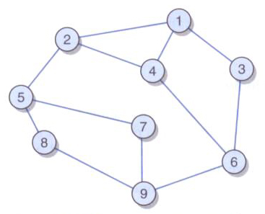
Graph Traversals
A traversal example:

Slide 22
Depth-First Traversal
Use nearly the same approach as the breadth-first traversal, but replace the queue with a stack
Additionally, do not mark a vertex as visited until it has been added to the iterator

Slide 23
/**
* Returns an iterator that performs a depth first traversal
* starting at the given index.
*
* @param startIndex the index from which to begin the traversal
* @return an iterator that performs a depth first traversal
*/
public Iterator<T> iteratorDFS(int startIndex)
{
Integer x;
boolean found;
StackADT<Integer> traversalStack = new LinkedStack<Integer>();
UnorderedListADT<T> resultList = new ArrayUnorderedList<T>();
boolean[] visited = new boolean[numVertices];
if (!indexIsValid(startIndex))
return resultList.iterator();
for (int i = 0; i < numVertices; i++)
visited[i] = false;
traversalStack.push(new Integer(startIndex));
resultList.addToRear(vertices[startIndex]);
visited[startIndex] = true;

Slide 24
while (!traversalStack.isEmpty())
{
x = traversalStack.peek();
found = false;
// Find a vertex adjacent to x that has not been visited
// and push it on the stack
for (int i = 0; (i < numVertices) && !found; i++)
{
if (adjMatrix[x.intValue()][i] && !visited[i])
{
traversalStack.push(new Integer(i));
resultList.addToRear(vertices[i]);
visited[i] = true;
found = true;
}
}
if (!found && !traversalStack.isEmpty())
traversalStack.pop();
}
return new GraphIterator(resultList.iterator());
}

Slide 25
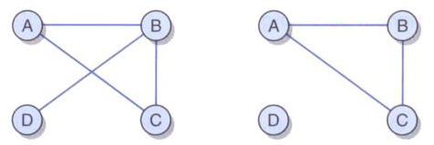
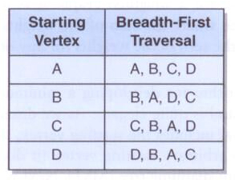
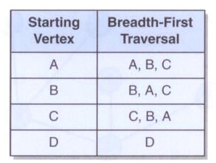
Connectivity
A graph is connected if and only if for each vertex v in a graph containing n vertices, the size of the result of a breadth-first traversal at v is n

Slide 26
Spanning Trees
A spanning tree is a tree that includes all of the vertices of a graph and some, but possibly not all, of the edges
Since trees are also graphs, for some graphs, the graph itself will be a spanning tree, and thus the only spanning tree

Slide 27
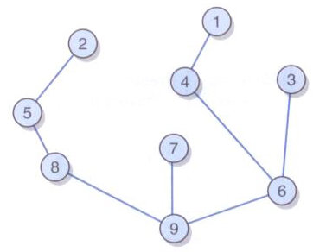
Spanning Tree
An example of a spanning tree:

Slide 28
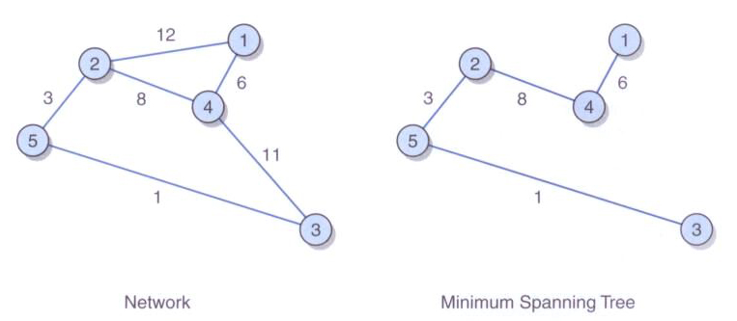
Minimum Spanning Tree
A minimum spanning tree (MST) is a spanning tree where the sum of the weights of the edges is less than or equal to the sum of the weights for any other spanning tree for the same graph

Slide 29
Minimum Spanning Tree
Minimal Spanning Tree algorithm overview
pick an arbitrary starting vertex and add it to our MST
add all of the edges that include our starting vertex to a minheap ordered by weight
remove the minimum edge from the minheap and add the edge and the new vertex to our MST
add to the minheap all of the edges that include this new vertex and whose other vertex is not already in the MST
continue until the minheap is empty or all vertices are in the MST

Slide 30
Shortest Path
There are two possibilities for determining the “shortest” path in a graph
determine the literal shortest path between a starting vertex and a target vertex (the least number of edges between the two vertices)
simplest approach – a variation of the breadth-first traversal algorithm
look for the cheapest path in a weighted graph
use a minheap or a priority queue storing vertex, weight pairs

Slide 31
Implementing Graphs
Strategies for implementing graphs:
Adjacency lists
use a set of graph nodes which contain a linked list storing the edges within each node
for weighted graphs, each edge would be stored as a triple including the weight
Adjacency matrices
use a two dimensional array
each position of the array represents an intersection between two vertices in the graph
each intersection is represented by a boolean value indicating whether or not the two vertices are connected

Slide 32
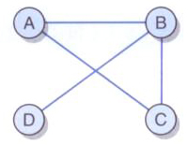
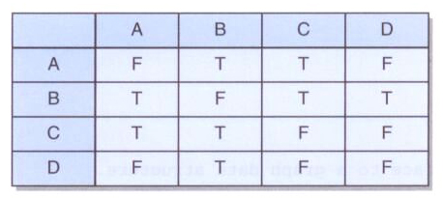
Adjacency Matrices
An undirected graph and it's adjacency matrix:

Slide 33
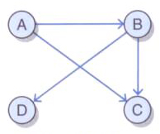
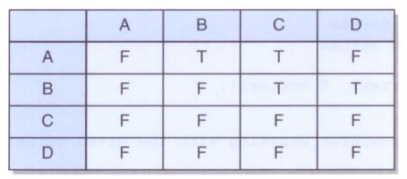
Adjacency Matrices
A directed graph and its adjacency matrix:

Slide 34
package jsjf;
import java.util.Iterator;
/**
* GraphADT defines the interface to a graph data structure.
*
* @author Lewis and Chase
* @version 4.0
*/
public interface GraphADT<T>
{
/**
* Adds a vertex to this graph, associating object with vertex.
*
* @param vertex the vertex to be added to this graph
*/
public void addVertex(T vertex);
/**
* Removes a single vertex with the given value from this graph.
*
* @param vertex the vertex to be removed from this graph
*/
public void removeVertex(T vertex);

Slide 35
/**
* Inserts an edge between two vertices of this graph.
*
* @param vertex1 the first vertex
* @param vertex2 the second vertex
*/
public void addEdge(T vertex1, T vertex2);
/**
* Removes an edge between two vertices of this graph.
*
* @param vertex1 the first vertex
* @param vertex2 the second vertex
*/
public void removeEdge(T vertex1, T vertex2);
/**
* Returns a breadth first iterator starting with the given vertex.
*
* @param startVertex the starting vertex
* @return a breadth first iterator beginning at the given vertex
*/
public Iterator iteratorBFS(T startVertex);

Slide 36
/**
* Returns a depth first iterator starting with the given vertex.
*
* @param startVertex the starting vertex
* @return a depth first iterator starting at the given vertex
*/
public Iterator iteratorDFS(T startVertex);
/**
* Returns an iterator that contains the shortest path between
* the two vertices.
*
* @param startVertex the starting vertex
* @param targetVertex the ending vertex
* @return an iterator that contains the shortest path
* between the two vertices
*/
public Iterator iteratorShortestPath(T startVertex, T targetVertex);
/**
* Returns true if this graph is empty, false otherwise.
*
* @return true if this graph is empty
*/
public boolean isEmpty();

Slide 37
/**
* Returns true if this graph is connected, false otherwise.
*
* @return true if this graph is connected
*/
public boolean isConnected();
/**
* Returns the number of vertices in this graph.
*
* @return the integer number of vertices in this graph
*/
public int size();
/**
* Returns a string representation of the adjacency matrix.
*
* @return a string representation of the adjacency matrix
*/
public String toString();
}

Slide 38
package jsjf;
import java.util.Iterator;
/**
* NetworkADT defines the interface to a network.
*
* @author Lewis and Chase
* @version 4.0
*/
public interface NetworkADT<T> extends GraphADT<T>
{
/**
* Inserts an edge between two vertices of this graph.
*
* @param vertex1 the first vertex
* @param vertex2 the second vertex
* @param weight the weight
*/
public void addEdge(T vertex1, T vertex2, double weight);
/**
* Returns the weight of the shortest path in this network.
*
* @param vertex1 the first vertex
* @param vertex2 the second vertex
* @return the weight of the shortest path in this network
*/
public double shortestPathWeight(T vertex1, T vertex2);
}

Slide 39
package jsjf;
import jsjf.exceptions.*;
import java.util.*;
/**
* Graph represents an adjacency matrix implementation of a graph.
*
* @author Lewis and Chase
* @version 4.0
*/
public class Graph<T> implements GraphADT<T>
{
protected final int DEFAULT_CAPACITY = 5;
protected int numVertices; // number of vertices in the graph
protected boolean[][] adjMatrix; // adjacency matrix
protected T[] vertices; // values of vertices
protected int modCount;
/**
* Creates an empty graph.
*/
public Graph()
{
numVertices = 0;
this.adjMatrix = new boolean[DEFAULT_CAPACITY][DEFAULT_CAPACITY];
this.vertices = (T[])(new Object[DEFAULT_CAPACITY]);
}

Slide 40
/**
* Inserts an edge between two vertices of the graph.
*
* @param vertex1 the first vertex
* @param vertex2 the second vertex
*/
public void addEdge(T vertex1, T vertex2)
{
addEdge(getIndex(vertex1), getIndex(vertex2));
}
/**
* Inserts an edge between two vertices of the graph.
*
* @param index1 the first index
* @param index2 the second index
*/
public void addEdge(int index1, int index2)
{
if (indexIsValid(index1) && indexIsValid(index2))
{
adjMatrix[index1][index2] = true;
adjMatrix[index2][index1] = true;
modCount++;
}
}

Slide 41
/**
* Adds a vertex to the graph, expanding the capacity of the graph
* if necessary. It also associates an object with the vertex.
*
* @param vertex the vertex to add to the graph
*/
public void addVertex(T vertex)
{
if ((numVertices + 1) == adjMatrix.length)
expandCapacity();
vertices[numVertices] = vertex;
for (int i = 0; i < numVertices; i++)
{
adjMatrix[numVertices][i] = false;
adjMatrix[i][numVertices] = false;
}
numVertices++;
modCount++;
}

Slide 42
/**
* Creates new arrays to store the contents of the graph with
* twice the capacity.
*/
protected void expandCapacity()
{
T[] largerVertices = (T[])(new Object[vertices.length*2]);
boolean[][] largerAdjMatrix =
new boolean[vertices.length*2][vertices.length*2];
for (int i = 0; i < numVertices; i++)
{
for (int j = 0; j < numVertices; j++)
{
largerAdjMatrix[i][j] = adjMatrix[i][j];
}
largerVertices[i] = vertices[i];
}
vertices = largerVertices;
adjMatrix = largerAdjMatrix;
}

